Slide 1
Hypothesis Testing
A statement has been made. We must decide whether to believe it (or not). Our belief decision must ultimately stand on three legs:
What does our general background knowledge and experience tell us (for example, what is the reputation of the speaker)?
What is the cost of being wrong (believing a false statement, or disbelieving a true statement)?
What does the relevant data tell us?

Slide 2
Making the “Belief” Decision
What does our general background knowledge and experience tell us (for example, what is the reputation of the speaker)? – The answer is typically already in the manager’s head.
What is the cost of being wrong (believing a false statement, or disbelieving a true statement)? – Again, the answer is typically already in the manager’s head.
What does the relevant data tell us? – The answer is typically not originally in the manager’s head. The goal of hypothesis testing is to put it there, in the simplest possible terms.
Then, the job of the manager is to pull these three answers together, and make the “belief” decision. The statistical analysis contributes to this decision, but doesn’t make it.

Slide 3
Our Goal is Simple:
To put into the manager’s head a single phrase which summarizes all that the data says with respect to the original statement.
“The data, all by itself, makes me ________ suspicious, because
the data, all by itself, contradicts the statement ________ strongly.”
{not at all, a little bit, moderately, quite, very, overwhelmingly}
We wish to choose the phrase which best fills the blanks.

Slide 4
What We Won’t Do
Compute Pr(statement is true | we see this data).
(This depends on our prior beliefs, instead of just on the data. It requires that we pull those beliefs out of the manager’s head.)
Compute Pr(we see this data | statement is true).
This depends just on the data. Since we don’t expect to see improbable things on a regular basis, a small value makes us very suspicious.
What We Will Do

Slide 5
This is Analogous to the British System of Criminal Justice
The statement on trial – the so-called “null hypothesis” – is that “the accused is innocent.”
The prosecution presents evidence.
The jury asks itself: “How likely is it that this evidence would have turned up, just by chance, if the accused really is innocent?”
If this probability is close to 0, then the evidence strongly contradicts the initial presumption of innocence … and the jury finds the accused “Guilty!”

Slide 6
Example: Processing a Loan Application
You’re the commercial loan officer at a bank, in the process of reviewing a loan application recently filed by a local firm. Examining the firm’s list of assets, you notice that the largest single item is $3 million in accounts receivable. You’ve heard enough scare stories, about loan applicants “manufacturing” receivables out of thin air, that it seems appropriate to check whether these receivables actually exist. You send a junior associate, Mary, out to meet with the firm’s credit manager.
Whatever report Mary brings back, your final decision of whether to believe that the claimed receivables exist will be influenced by the firm’s general reputation, and by any personal knowledge you may have concerning the credit manager. As well, the consequences of being wrong – possibly approving an overly-risky loan if you decide to believe the receivables are there and they’re not, or alienating a commercial client by disbelieving the claim and requiring an outside credit audit of the firm before continuing to process the application, when indeed the receivables are as claimed – will play a role in your eventual decision.

Slide 7
Processing a Loan Application
Later in the day, Mary returns from her meeting. She reports that the credit manager told her there were 10,000 customers holding credit accounts with the firm. He justified the claimed value of receivables by telling her that the average amount due to be paid per account was at least $300.
With his permission, she confirmed (by physical measurement) the existence of about 10,000 customer folders. (You decide to accept this part of the credit manager’s claim.) She selected a random sample of 64 accounts at random, and contacted the account-holders. They all acknowledged soon-to-be-paid debts to the firm. The sample mean amount due was $280, with a sample standard deviation of $120.
What do we make of this data? It contradicts the claim to some extent, but how strongly? It could be that the claim is true, and Mary simply came up with an underestimate due to the randomness of her sampling (her “exposure to sampling error”).

Slide 8
Compute, then Interpret
What do we make of Mary’s data? We answer this question in two steps. First, we compute Pr(we see this data | statement is true). More precisely:
This number is called the significance level of the data, with respect to the statement under investigation (i.e., with respect to the null hypothesis). (Some authors/software call this significance level the “p-value” of the data.)
Then, we interpret the number: A small value forces us to say, “Either the statement is true, and we’ve been very unlucky (i.e., we’ve drawn a very misrepresentative sample), or the statement is false. We don’t typically expect to be very unlucky, so the data, all by itself, makes us quite suspicious.”
Pr ( | conducting a study such as we just did, we’d see data at least as contradictory to the statement as the data we are, in fact, seeing | | | the statement is true, in a way that fits the observed data as well as possible | )

Slide 9
Null Hypothesis: “μ≥$300”
Mary’s sample mean is $280. Giving the original statement every possible chance of being found “innocent,” we’ll assume that Mary did her study in a world where the true mean is actually $300.
Let be the estimate Mary might have gotten, had she done her study in this assumed world.

Slide 10
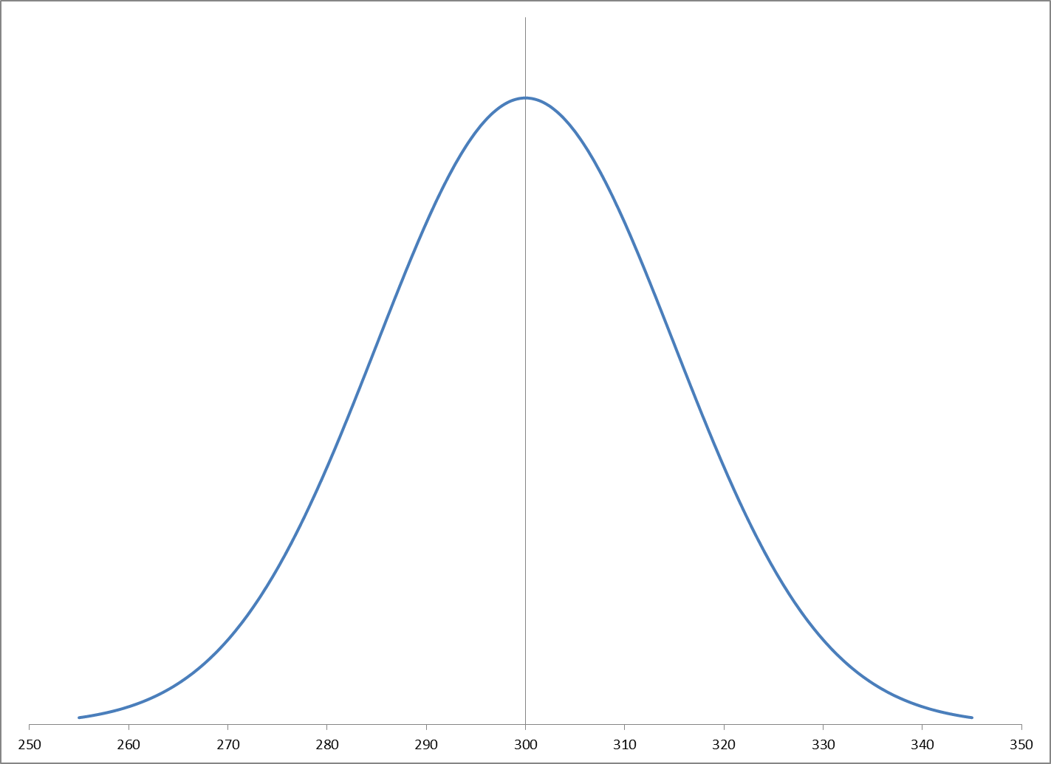
The significance level of Mary’s data, with respect to the null hypothesis: “μ ≥ $300”, is
The probability that Mary’s study would have yielded a sample mean of $280 or less, given that her study was actually done in a world where the true mean is $300.
μ = $300
s/√n = $120/√64 = $15
the t-distribution with 63 degrees of freedom
9.36%

Slide 11
The “Hypothesis Testing Tool”
The spreadsheet “Hypothesis_Testing_Tool.xls,” in the “Session 1” folder, does the required calculations automatically.

Slide 12
And now, how do we interpret “9.36%”?
Coin_Tossing.htm
numeric significance level of the data | interpretation: the data, all by itself, makes us | the data supports the alternative hypothesis
above 20% | not at all suspicious | not at all
between 10% and 20% | a little bit suspicious | a little bit
between 5% and 10% | moderately suspicious | moderately
between 2% and 5% | very suspicious | strongly
between 1% and 2% | extremely suspicious | very strongly
below 1% | overwhelmingly suspicious | incredibly strongly

Slide 13
Processing a Loan Application
So the data, all by itself, makes us “a bit suspicious.” What do we do?
It depends.
  If the credit manager is a trusted lifelong friend …
  If the credit manager is already under suspicion …
What if Mary’s sample mean were $260?
  With a significance level of 0.49%, the data, all by itself, makes us “overwhelmingly suspicious” …

Slide 14
The One-Sided Complication
A jury never finds the accused “innocent.”
  For example, if the prosecution presents no evidence at all, the jury simply finds the accused “not proven to be guilty.”
Just so, we never conclude that data supports the null hypothesis.
  However, if data contradicts the null hypothesis, we can conclude that it supports the alternative.

Slide 15
So, If We Wish to Say that Data Supports a Claim …
We take the opposite of the claim as our null hypothesis, and see if the data contradicts that opposite. If so, then we can say that the data supports the original claim.
Examples:
  A clinical test of a new drug will take as the null hypothesis that patients who take the drug are equally or less healthy than those who don’t.
  An evaluation of a new marketing campaign will take as the null hypothesis that the campaign is not effective.

